Slide 1
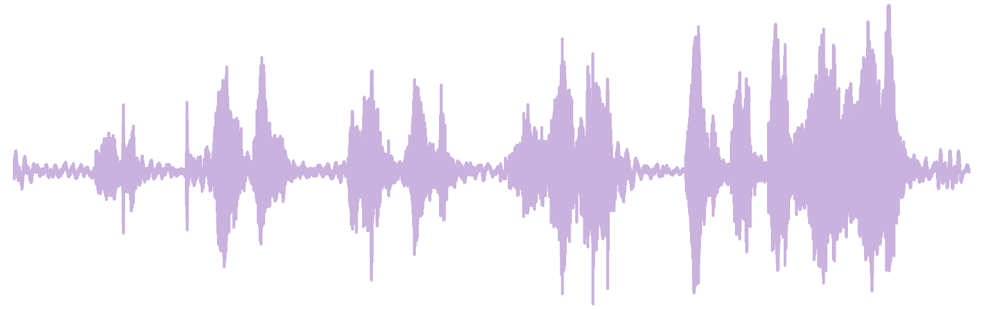
Bayesian Neural Network Audio Classifiers
Student: Jack Robert Norrie
Supervisor: Dr Kevin Webster
Github: https://github.com/jack-norrie/bayesian_deep_learning_for_audio_classification

Slide 2
Contents
Outline
Theory
Method
Results
Conclusion

Slide 3

Outline

Slide 4
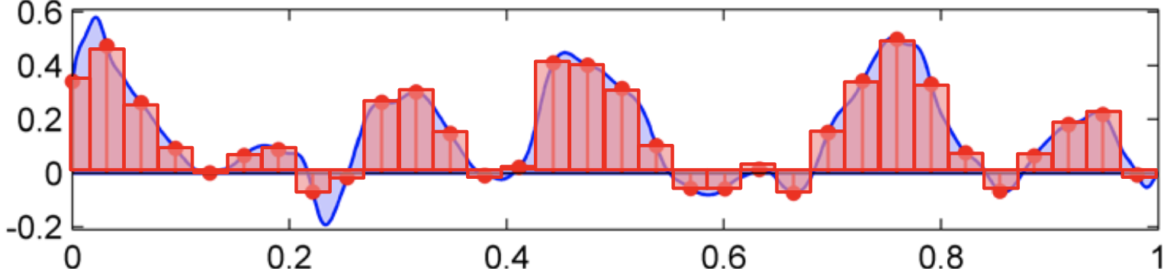
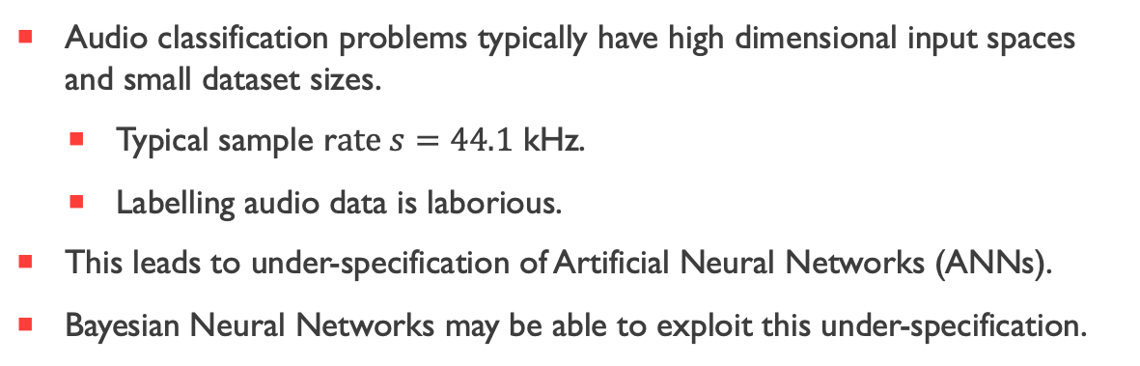
The Problem
Audio classification problems typically have high dimensional input spaces and small dataset sizes.
Typical sample r$ate s=44.1$ kHz.
Labelling audio data is laborious.
This leads to under-specification of Artificial Neural Networks (ANNs).
Bayesian Neural Networks may be able to exploit this under-specification.
[1]

Slide 5

Theory

Slide 6
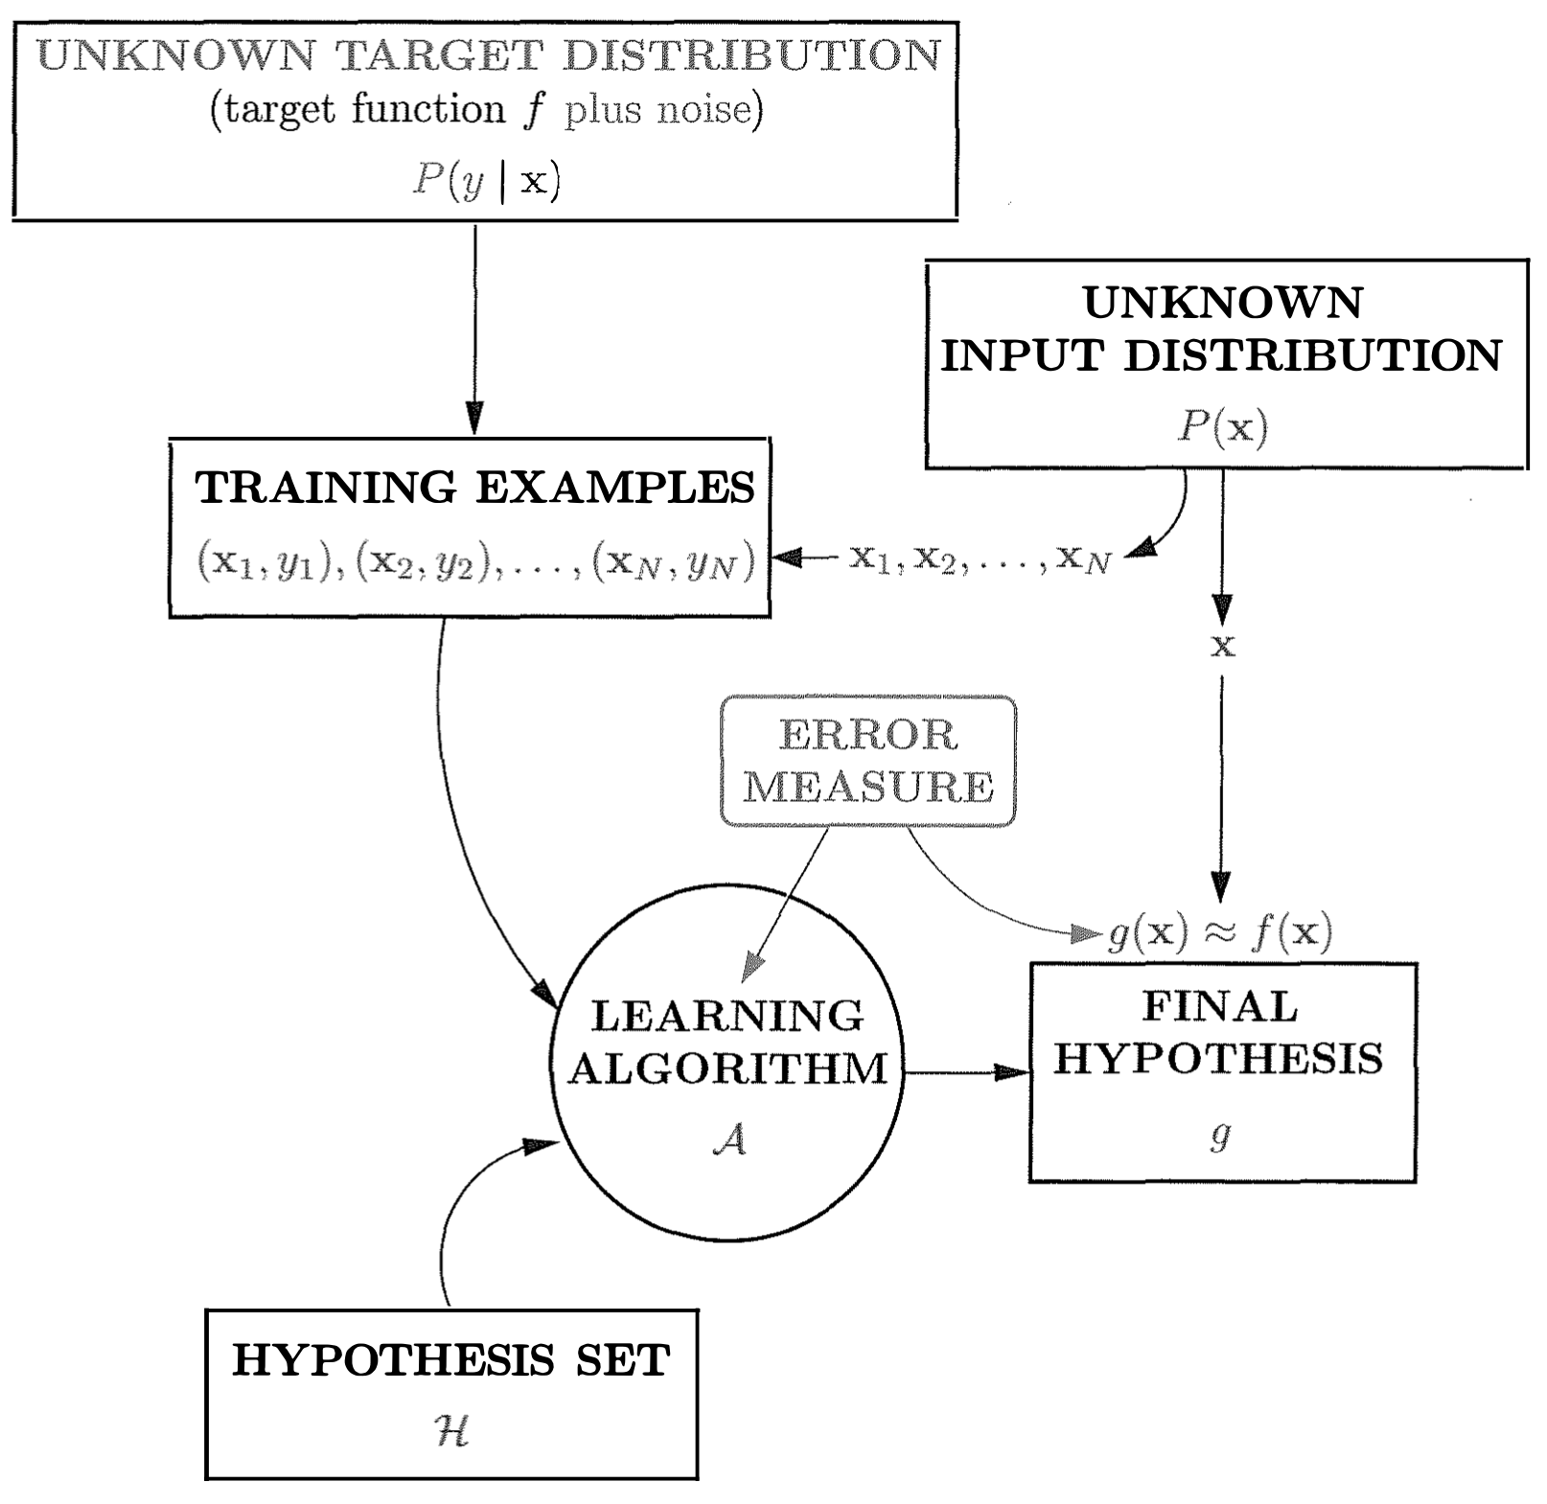
Supervised Learning
[2]

Slide 7
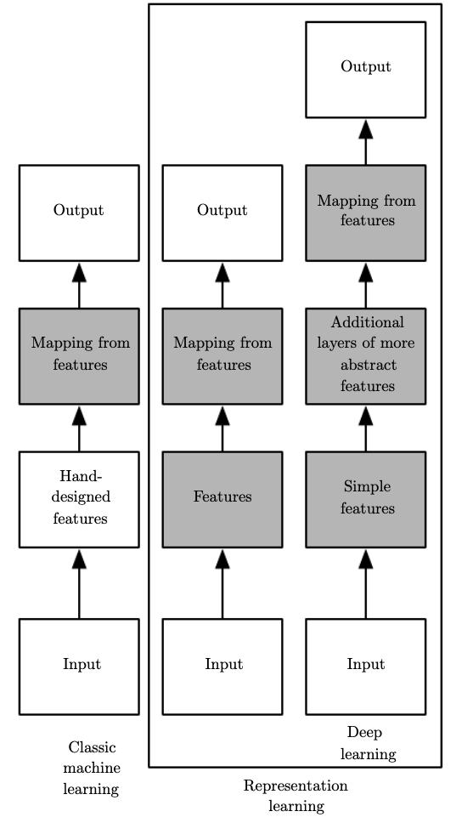
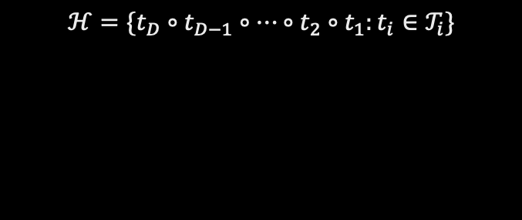
Deep Learning
$$ℋ=\{t_{D}∘t_{D−1}∘…∘t_{2}∘t_{1}:t_{i}∈𝒯_{i}\}$$
[3]

Slide 8



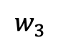
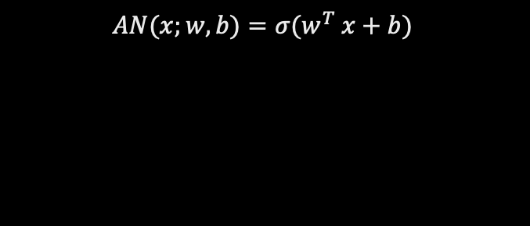

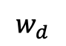

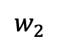

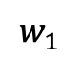
The Mathematical Neuron
$${ x}_{1}$$
$$w_{1}$$
b
$${ x}_{2}$$
$$w_{2}$$
$$w_{3}$$
$$∑$$
$$σ$$
$${ x}_{3}$$
$$AN(x;w, b)=σ(w^{T} x+b)$$
$$w_{d}$$
$${ x}_{d}$$

Slide 9
Artificial Neural Networks
Artificial Neural Network
Feedforward Neural Network
Multilayer Perceptron

Slide 10
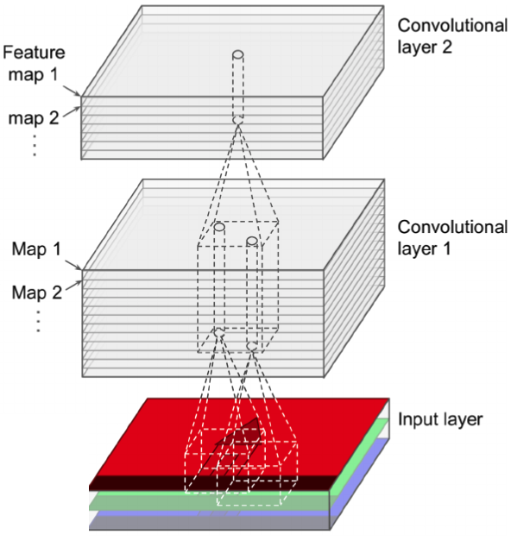
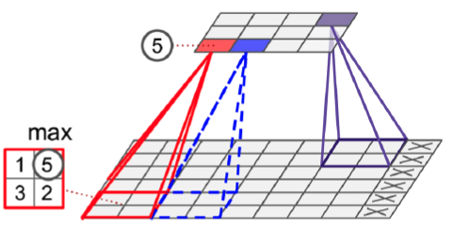
Convolutional Neural Networks
Convolutional Layer:
Sparsity
Parameter Sharing
Equivariance to translation
Pooling Layer:
Dimensionality reduction
Translational invariance
[4]
[4]

Slide 11
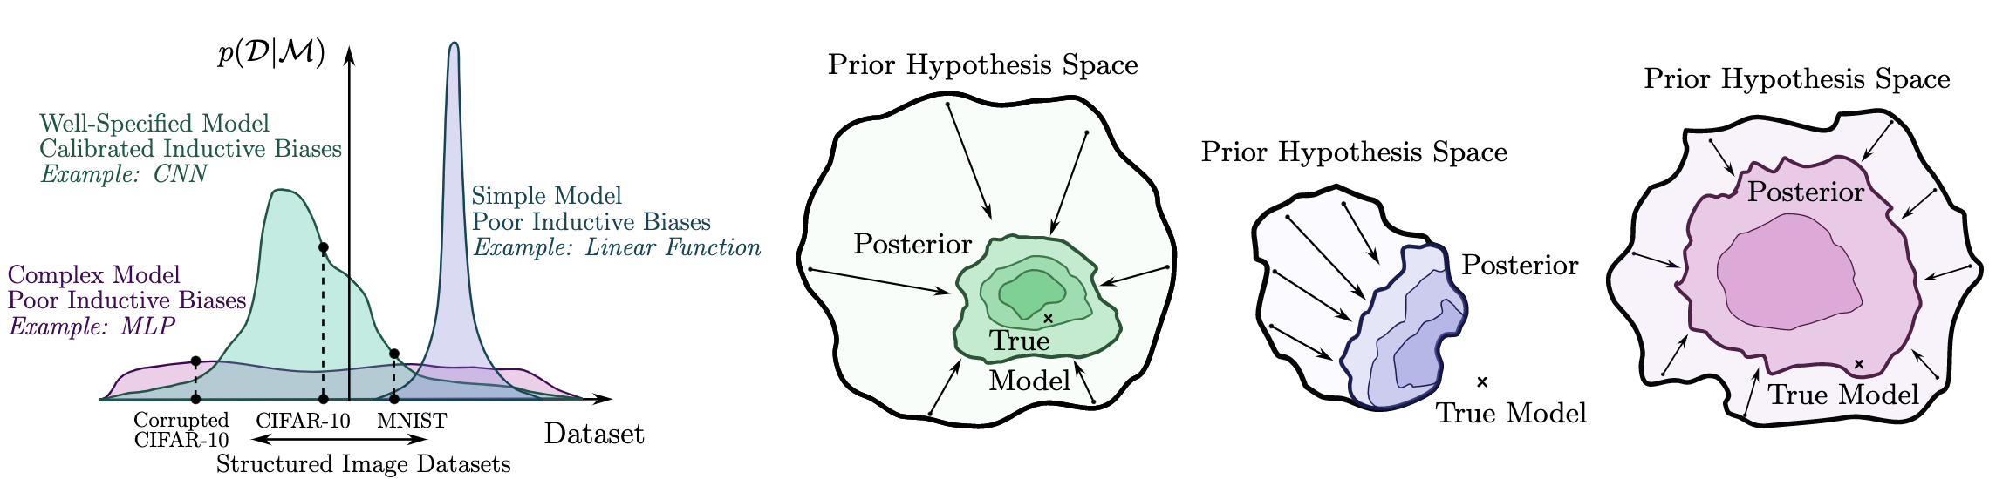
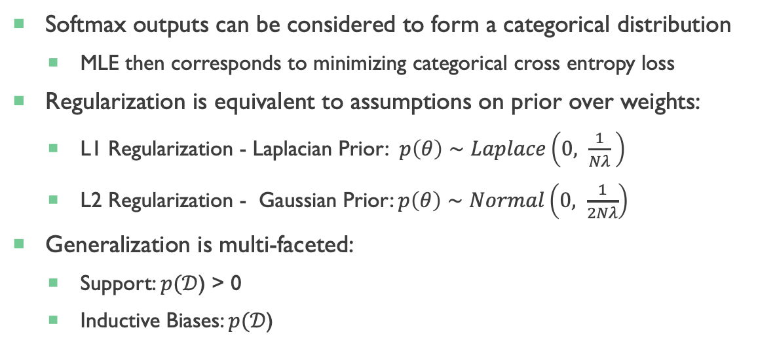
Artificial Neural Networks as Probabilistic models
Softmax outputs can be considered to form a categorical distribution
MLE then corresponds to minimizing categorical cross entropy loss
Regularization is equivalent to assumptions on prior over weights:
L1 Regularization - Laplacian Prior: $p\left(θ\right)∼Laplace\left(0, \frac{1}{Nλ} \right)$
L2 Regularization - Gaussian Prior: $p\left(θ\right)∼Normal\left(0, \frac{1}{2Nλ}\right)$
Generalization is multi-faceted:
Support: $p(𝒟$) > 0
Inductive Biases: $p(𝒟$)
[5]

Slide 12
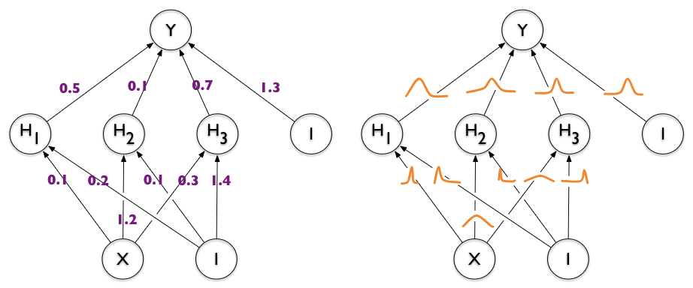
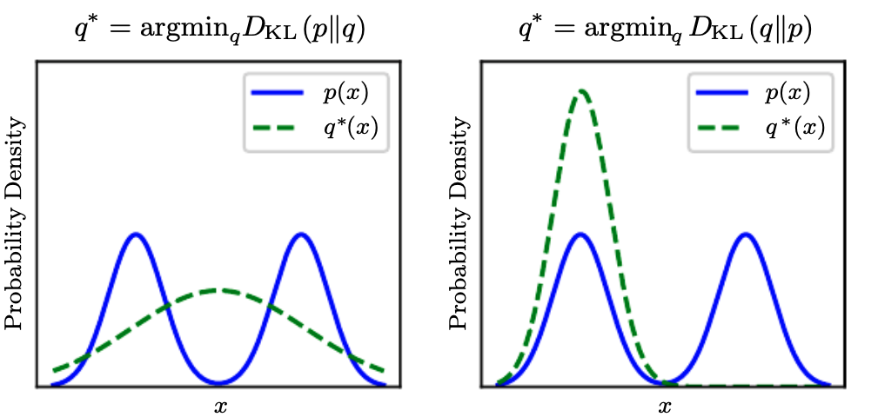
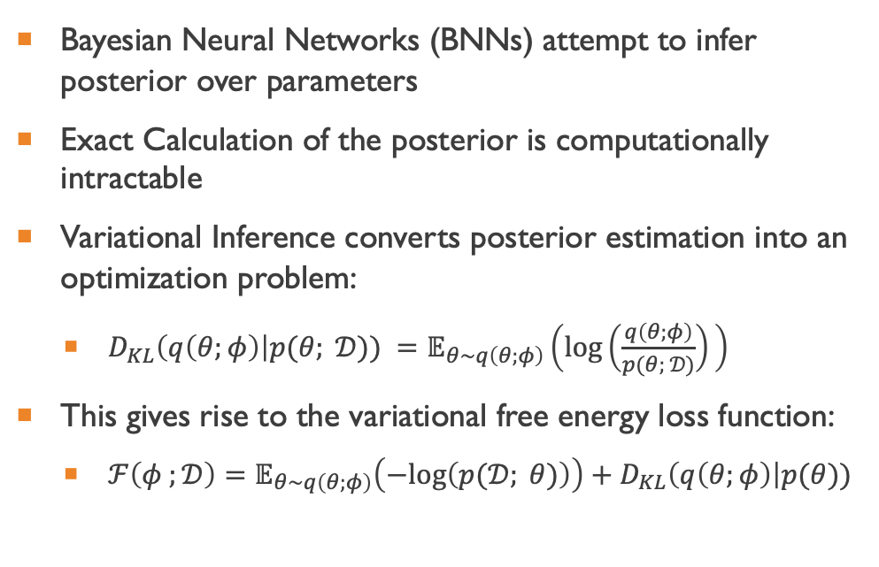
Bayesian Neural Networks
Bayesian Neural Networks (BNNs) attempt to infer posterior over parameters
Exact Calculation of the posterior is computationally intractable
Variational Inference converts posterior estimation into an optimization problem:
$D_{KL}\left(q\left(θ;φ\right)\right|p(θ; 𝒟)) =𝔼_{θ∼q\left(θ;φ\right)}\left(log\left(\frac{q\left(θ;φ\right)}{p(θ; 𝒟)}\right)⁡\right)$
This gives rise to the variational free energy loss function:
$ℱ\left(φ ;𝒟\right)=𝔼_{θ∼q\left(θ;φ\right)}\left(−log\left(p(𝒟; θ)\right)\right)+D_{KL}\left(q\left(θ;φ\right)\right|p(θ))$
[6]
[3]

Slide 13
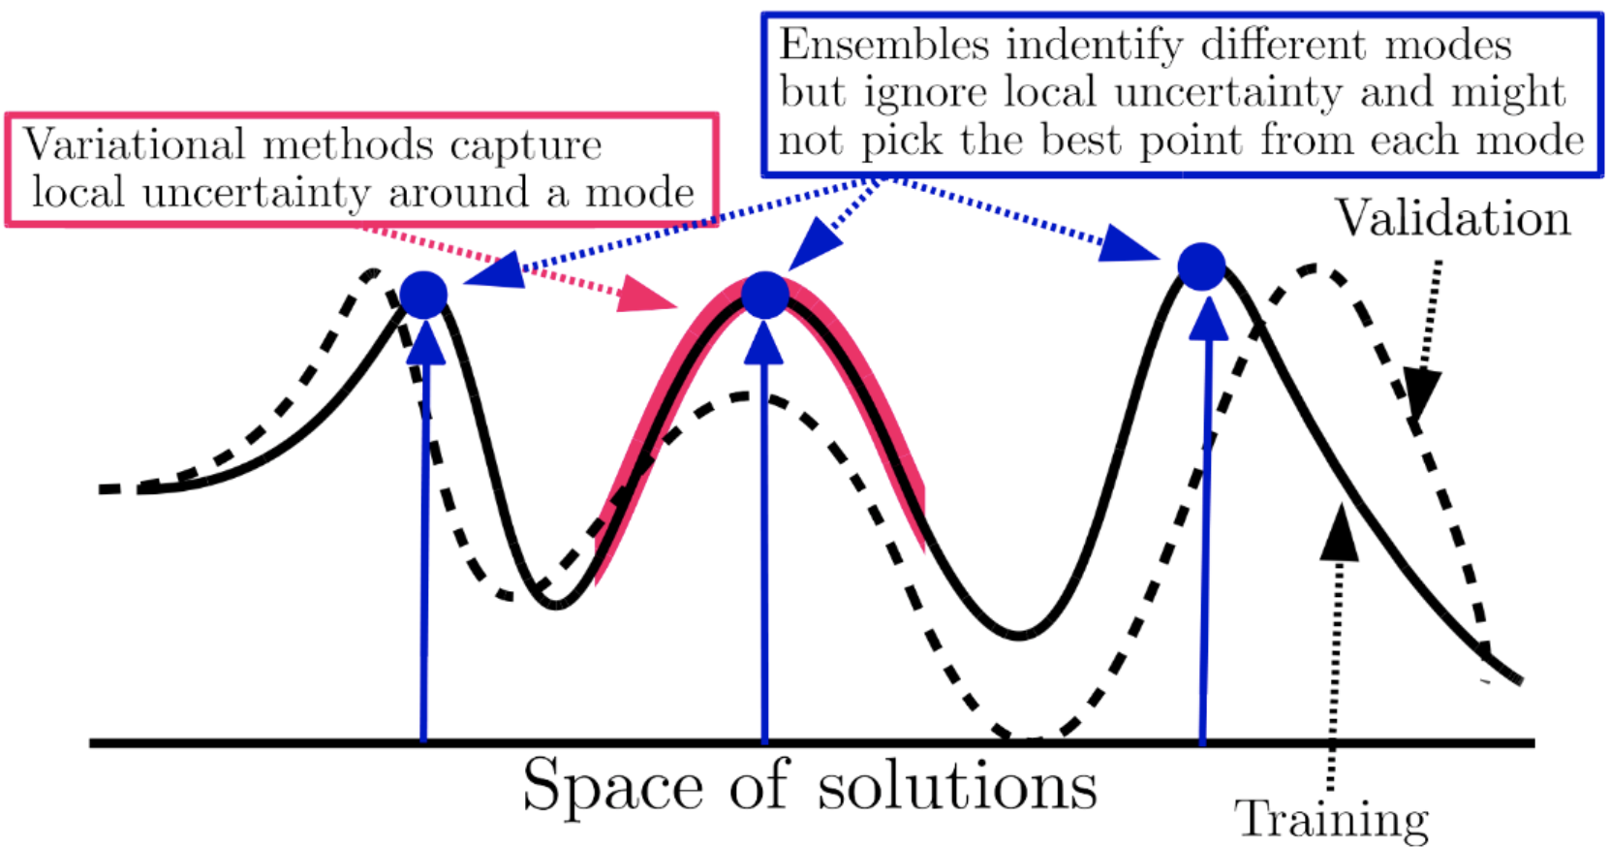
Deep Ensembles
Train M different Neural networks with different initializations
Better performance than BNNs
More computationally expensive
[7]

Slide 14

Method

Slide 15
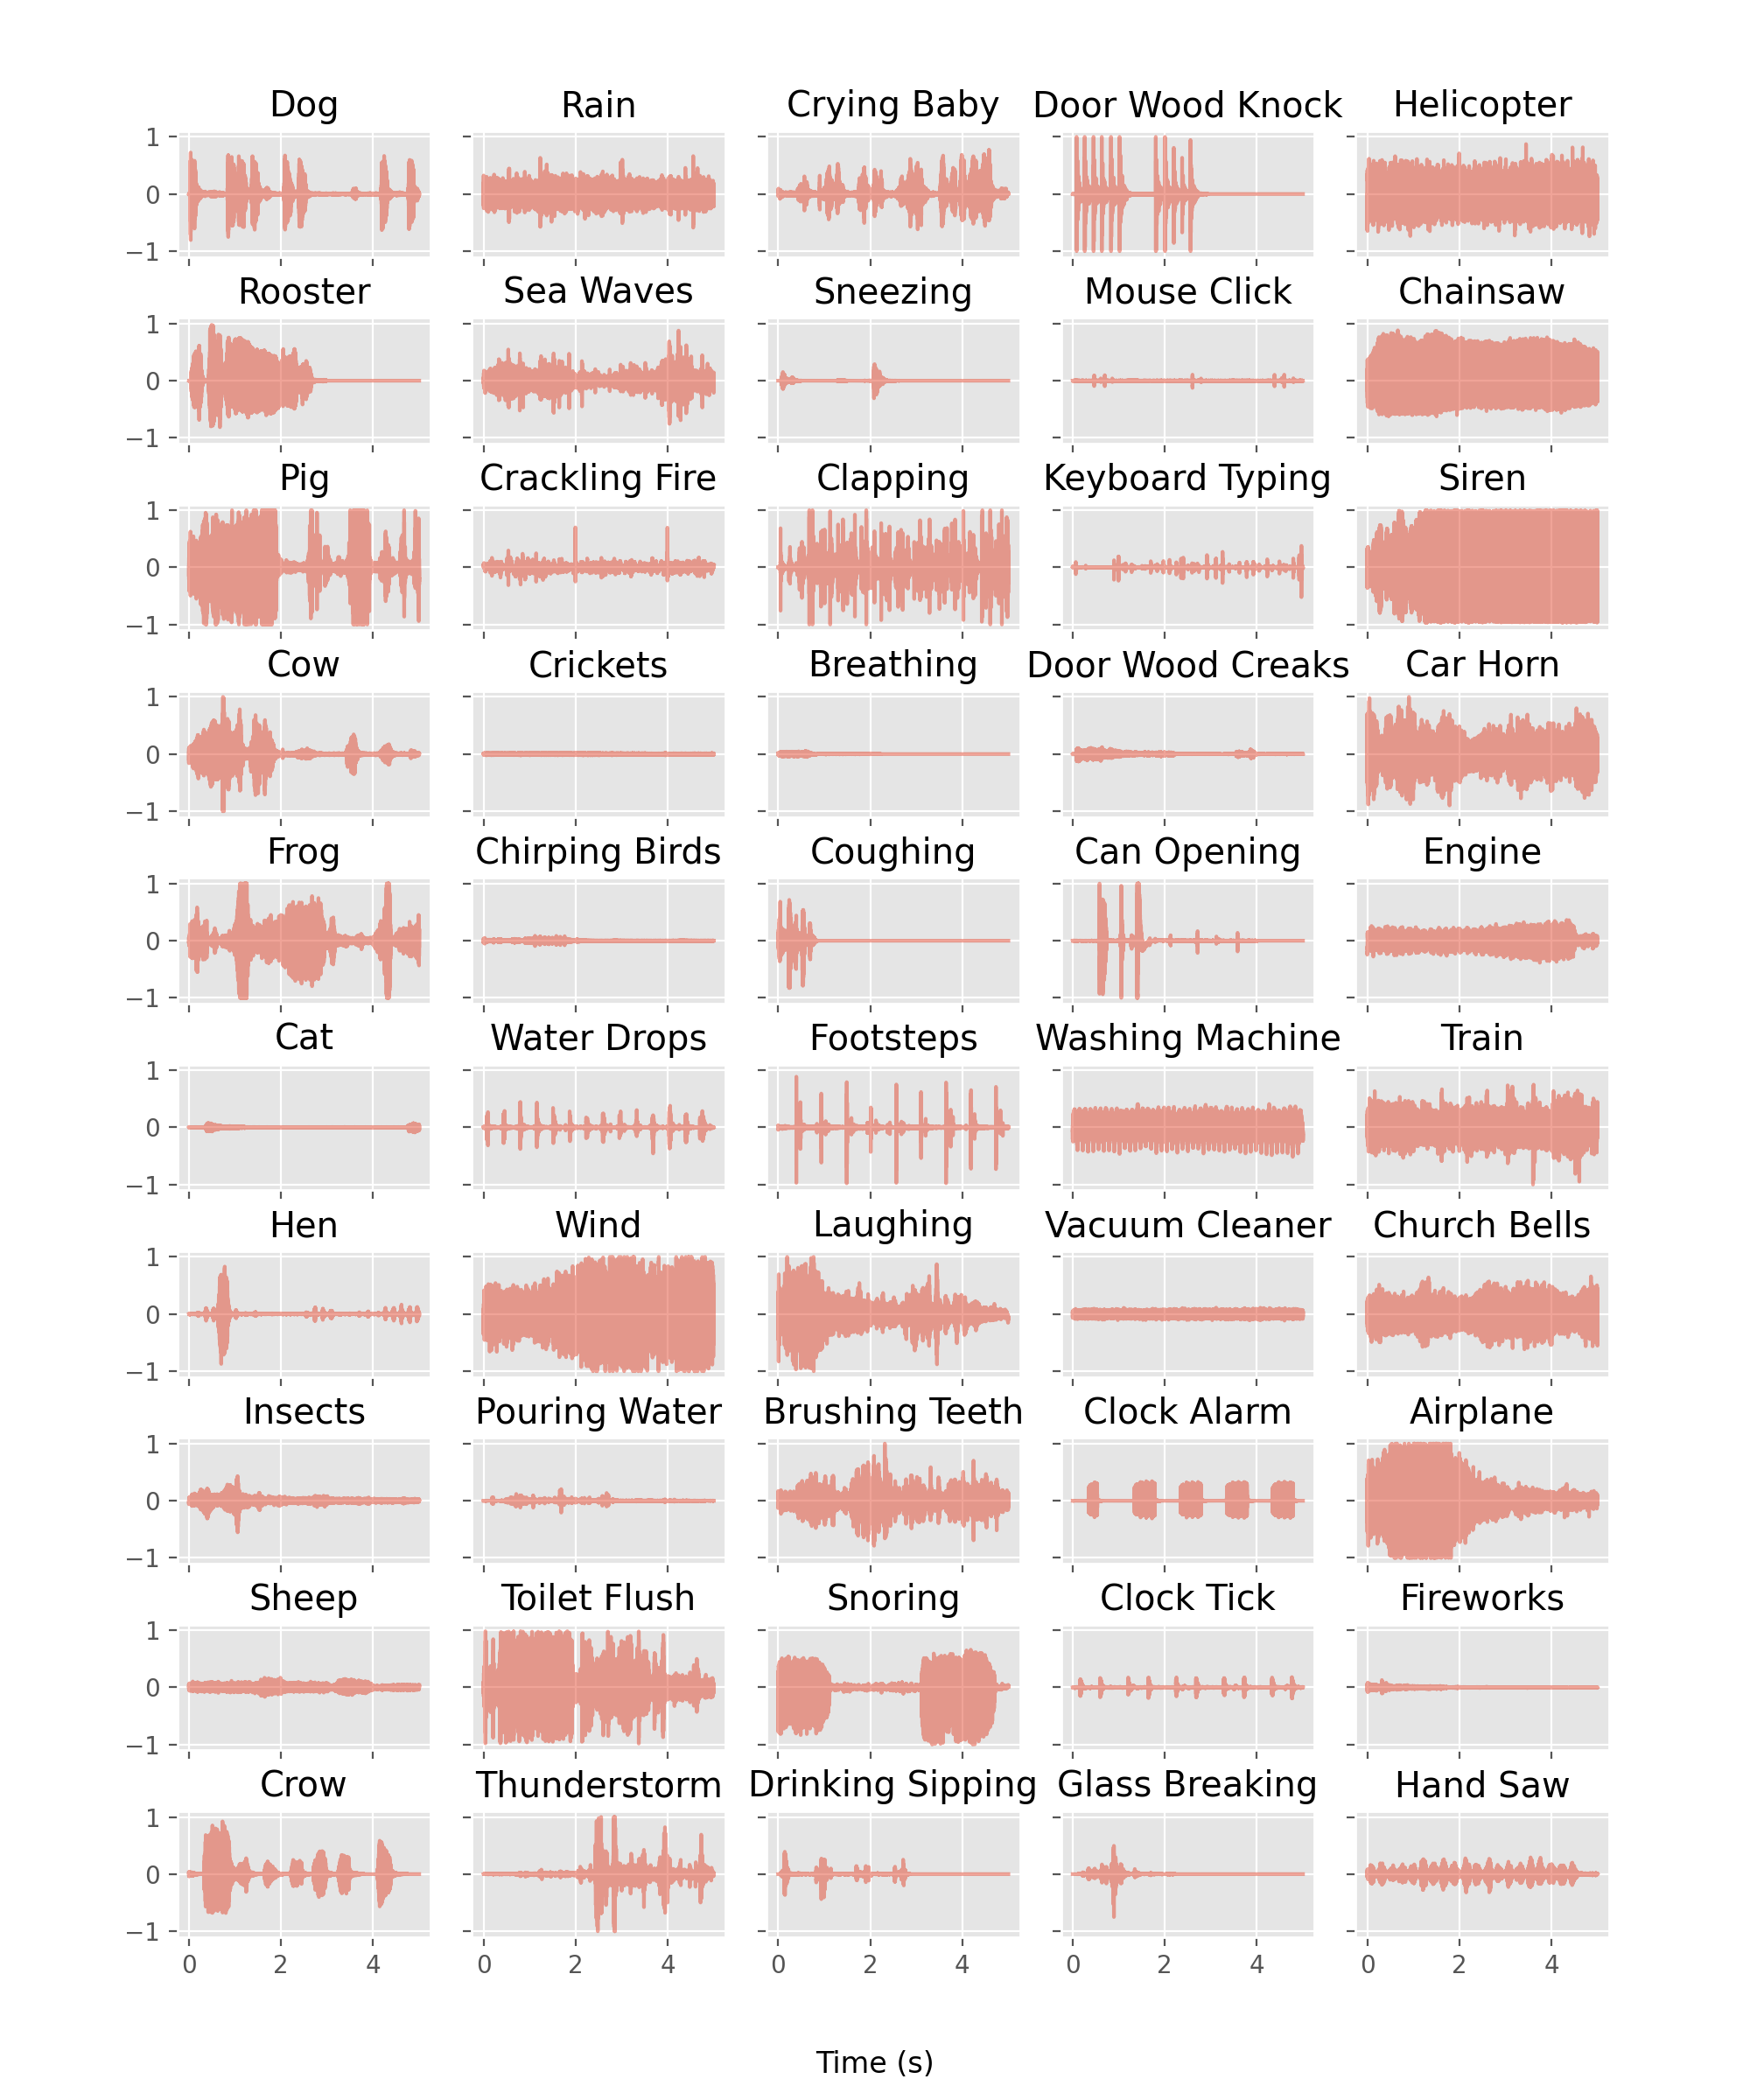
ESC-50: Dataset for Environmental Sound Classification
2000 5s audio recordings of environmental sounds
5 class categories
Animal
Landscape
Human
Urban Interior
Urban Exterior
50 classes
40 observations per class
44.1 kHz sample rate
16 bits/sample bit depth
Pre-defined 5-fold cross validation folds

Slide 16
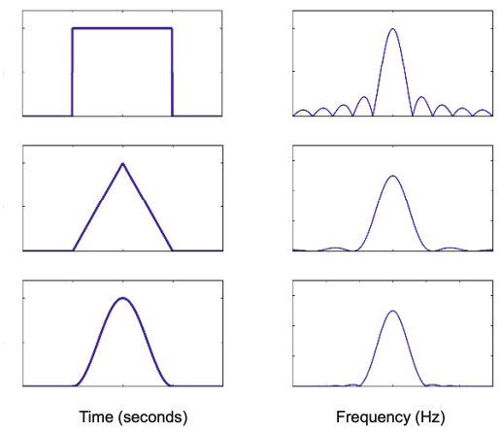
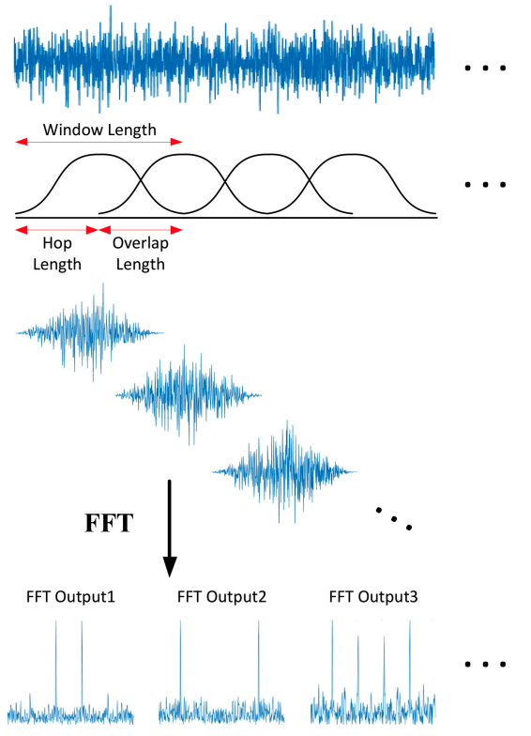
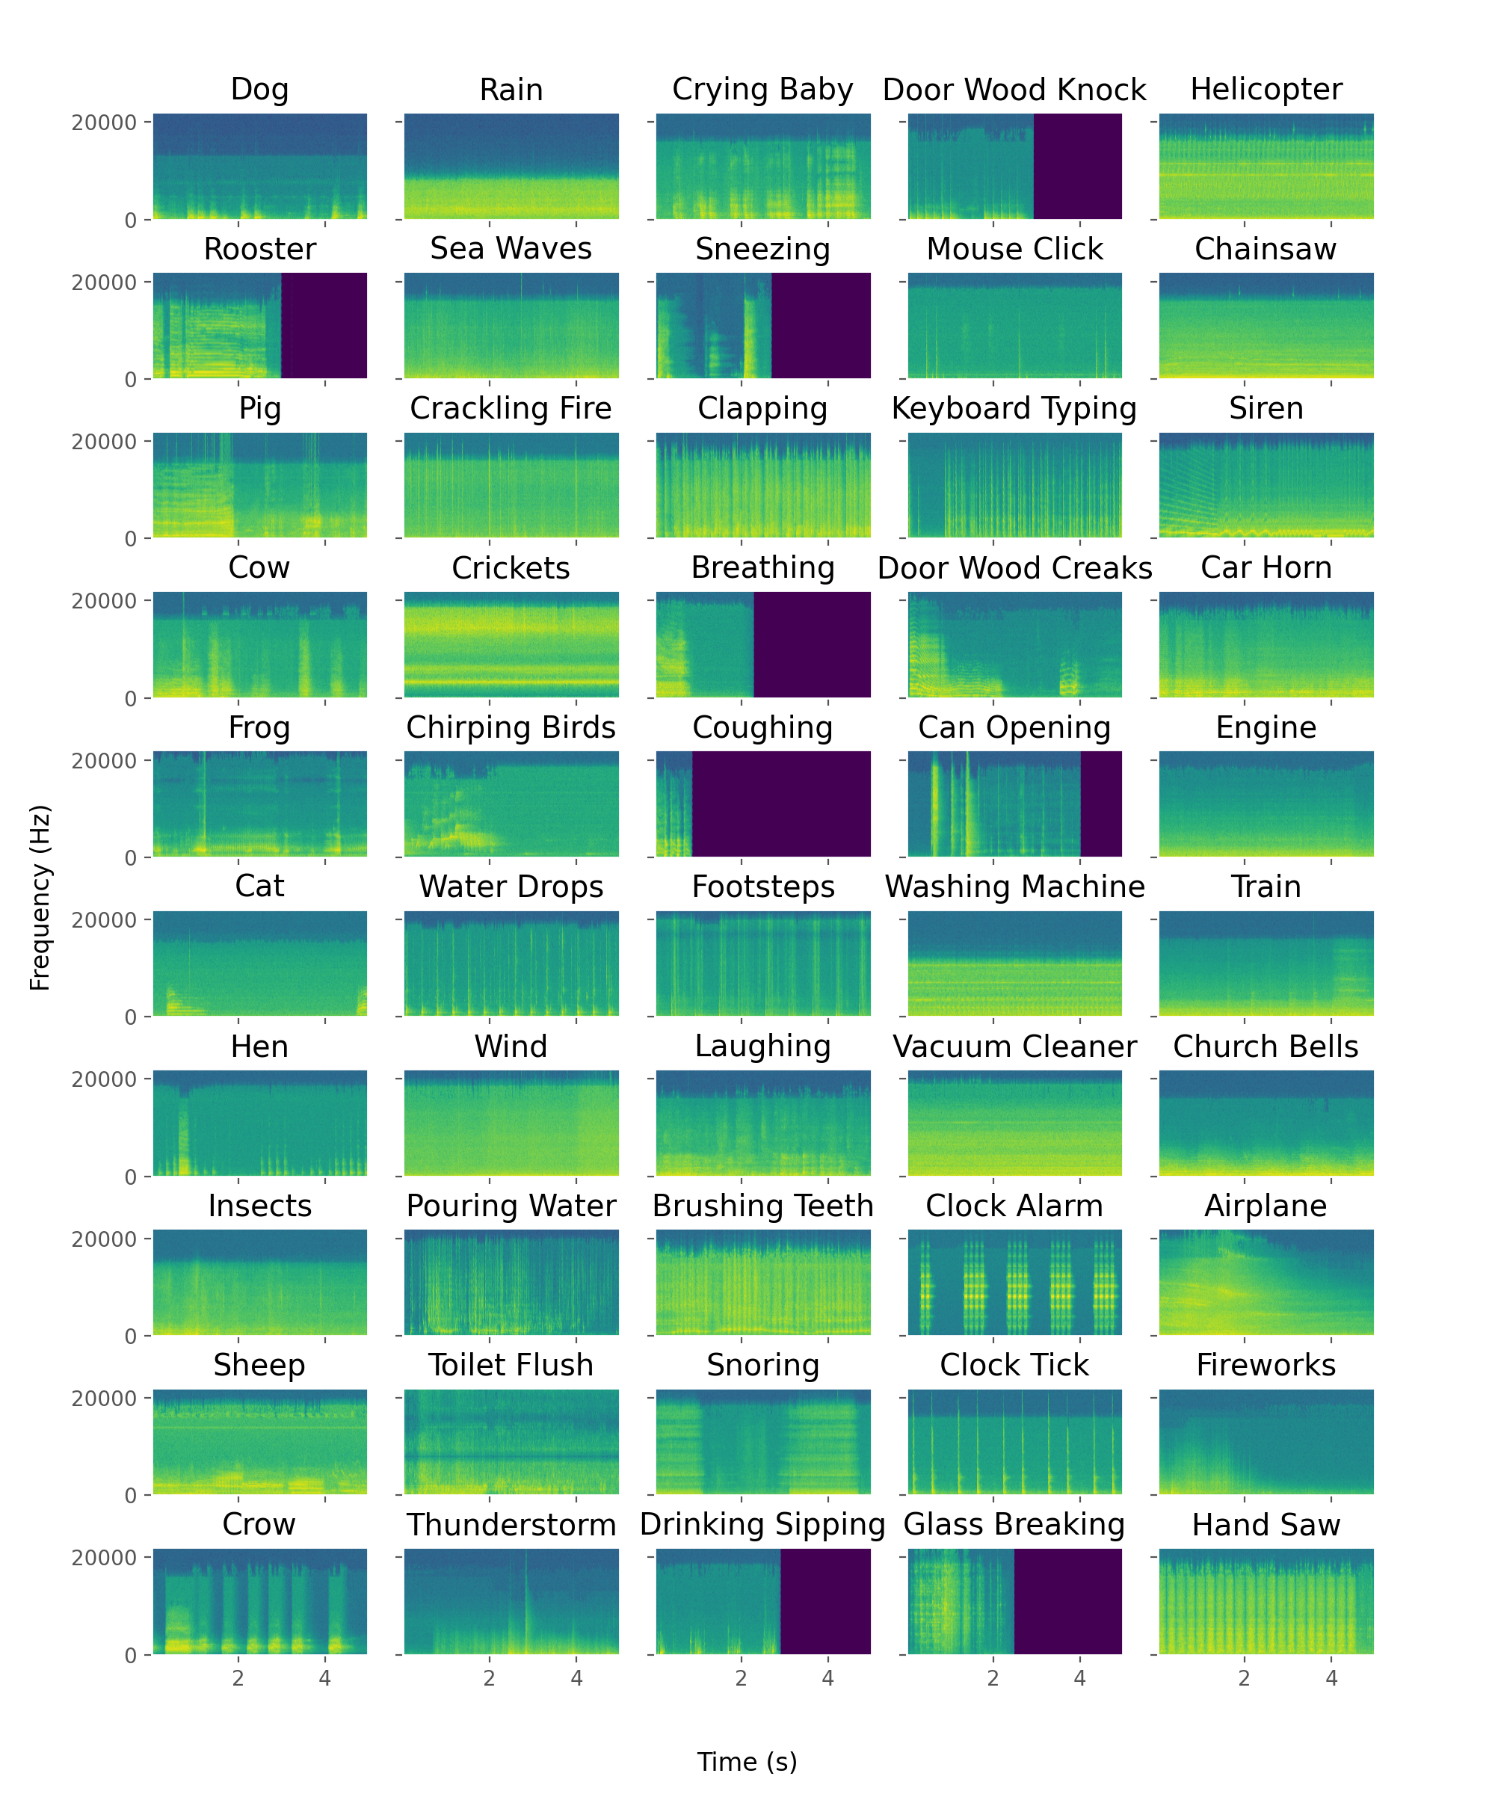
Spectrograms
[1]
[8]

Slide 17
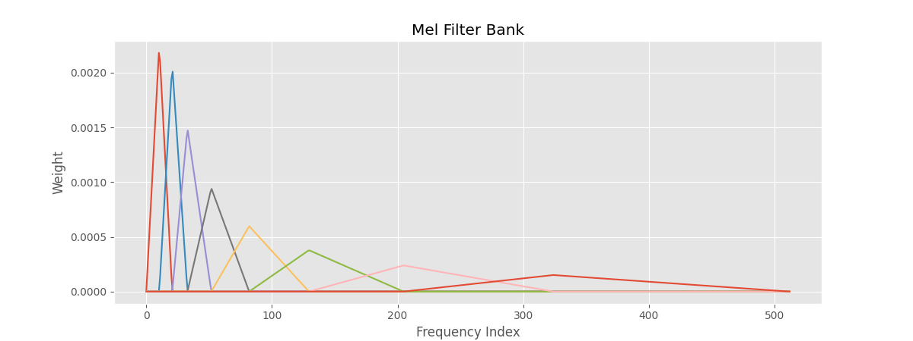
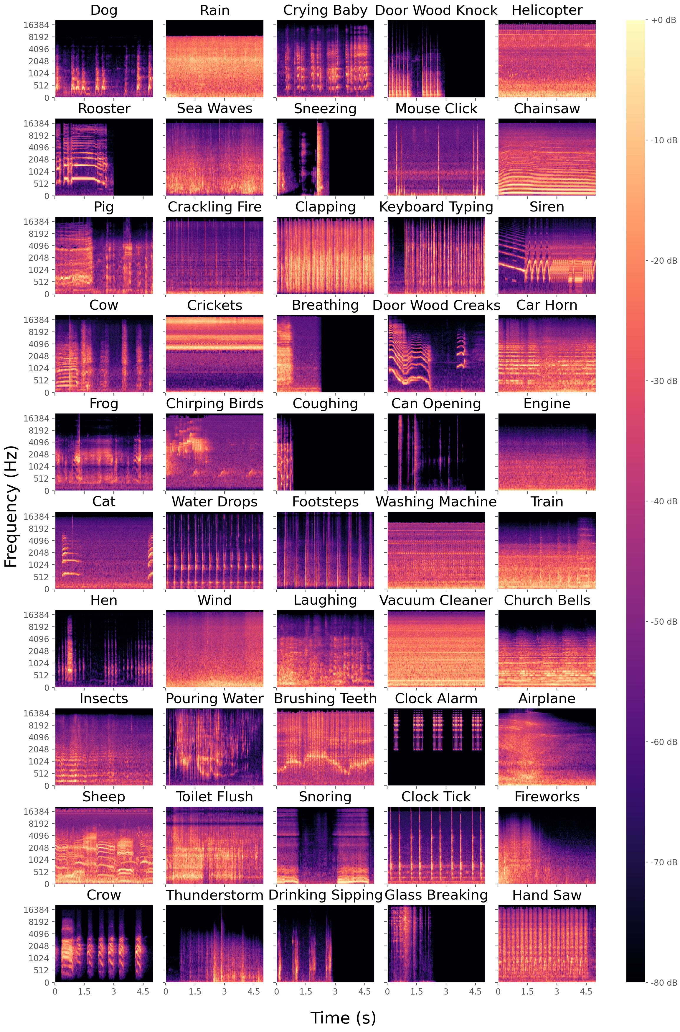
Mel-Spectrograms
$m=2595\log_{10}\left(1+\frac{f}{700}\right)$ [9]

Slide 18
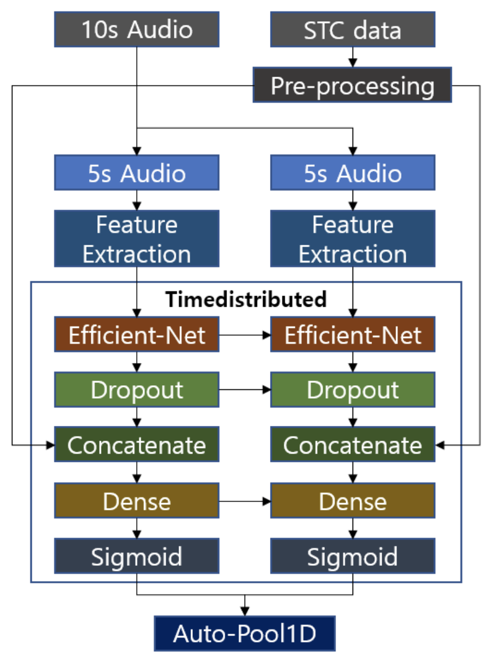
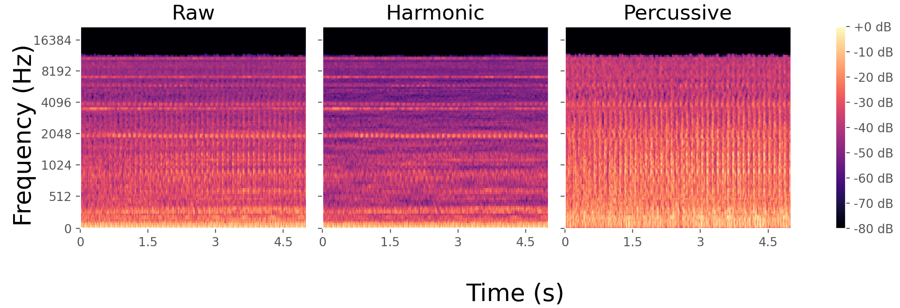

Multi-Channel Spectrogram Model
[10]
Reported 5-fold classification: $89.5\%$
Implemented training accuracy: $≈90\%$
Implemented validation accuracy $≈30\%$

Slide 19
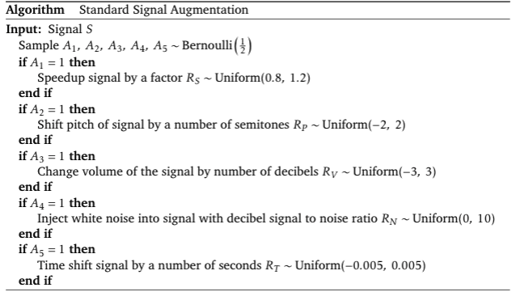
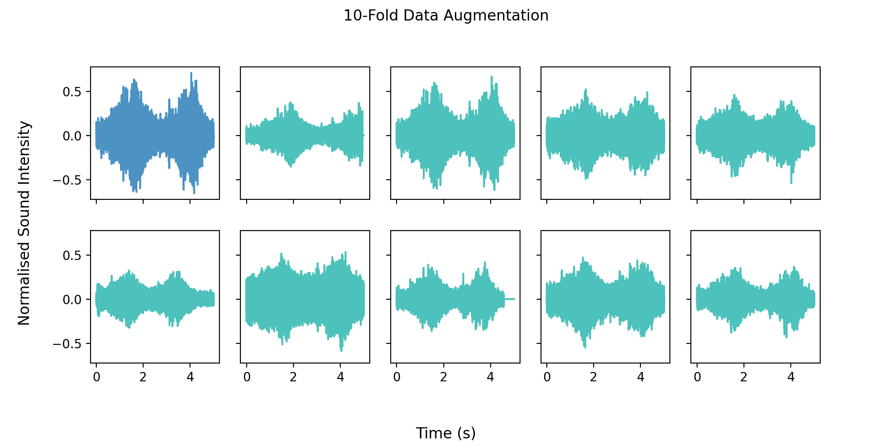
Data Augmentation
[11]

Slide 20
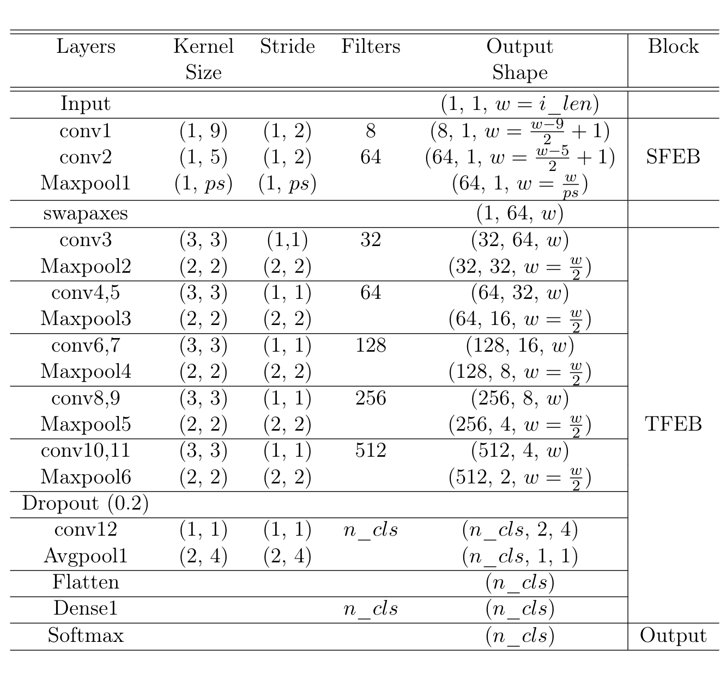

ACDNet
Reported 5-fold classification: 87.1%
$i_{len}=220500$
$A_{train}≈95\%$
$A_{val}≈50\%$
$i_{len}=33333$
$A_{train}≈95\%$
$A_{val}≈55\%$
[12]

Slide 21
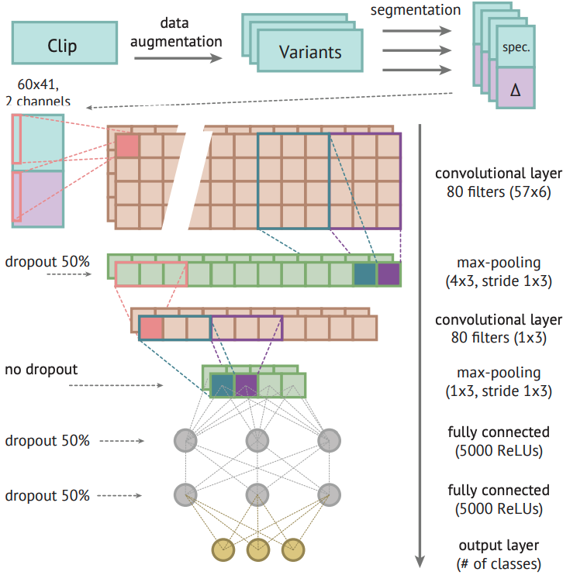
CNN Baseline
[13]

Slide 22
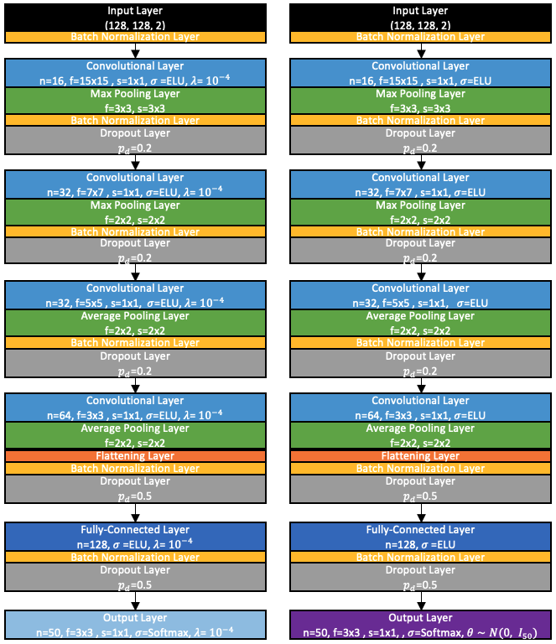
Proposed Network

Slide 23

Results

Slide 24
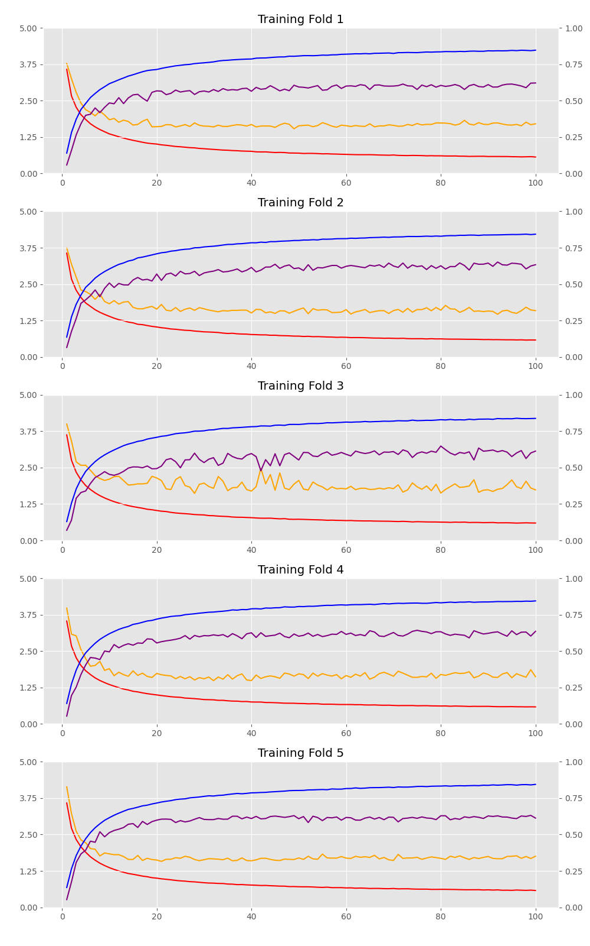
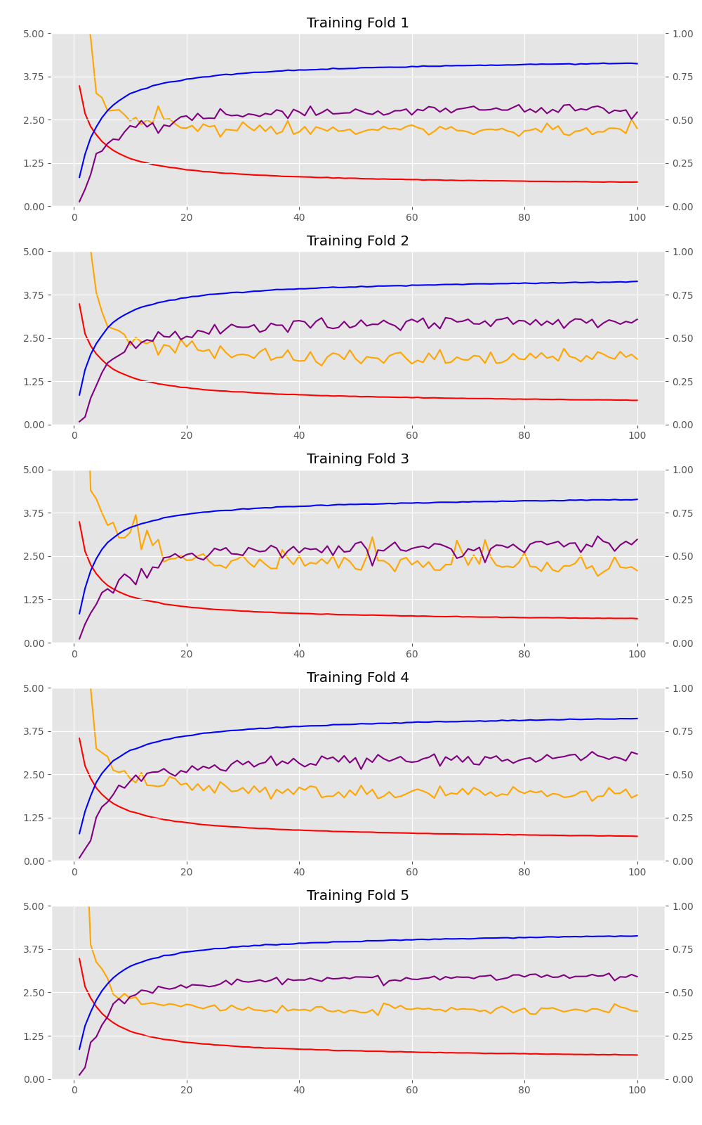
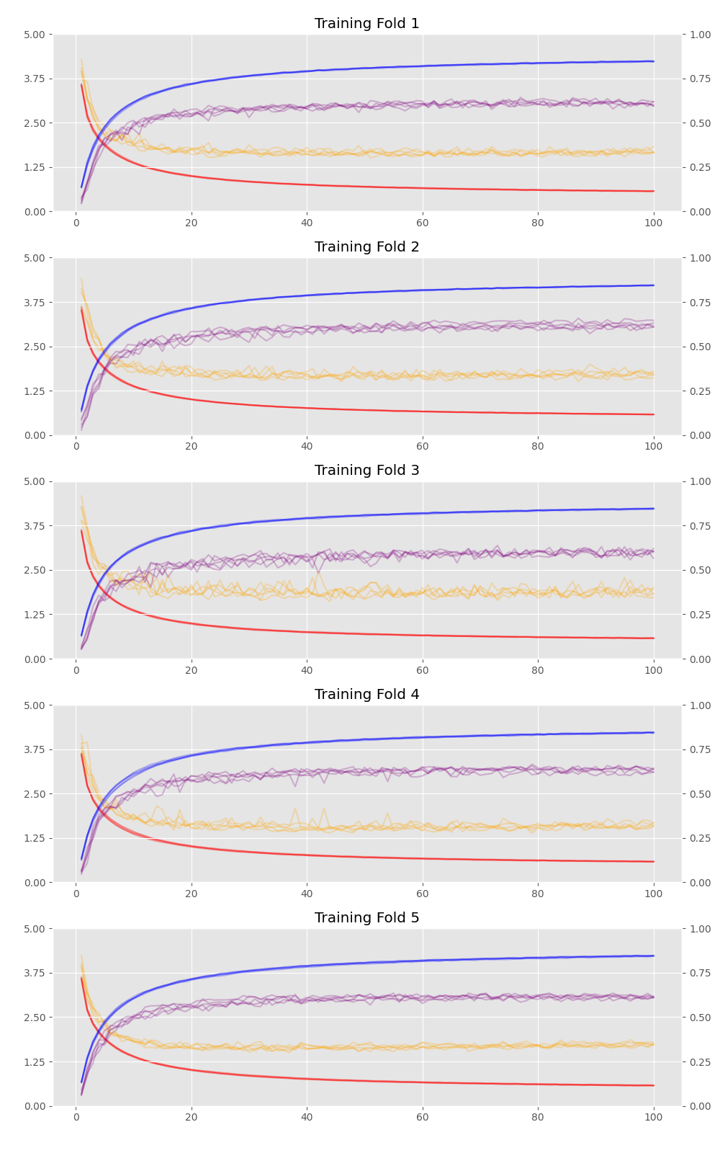
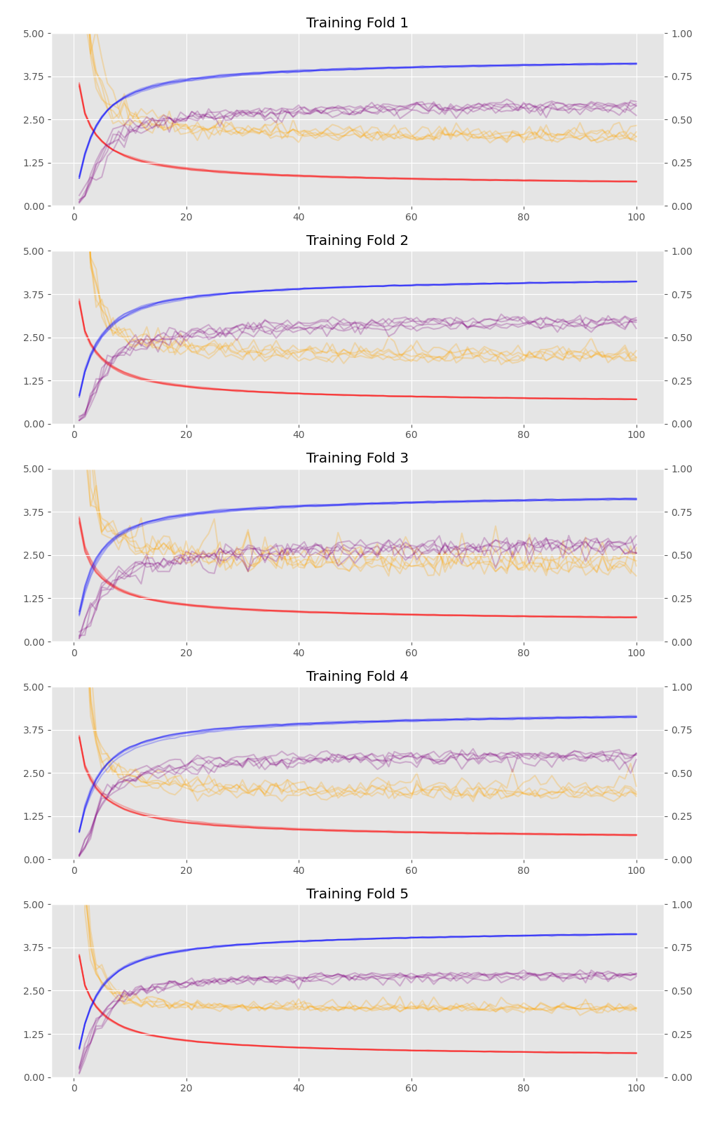
Learning Curves
CNN
BNN
CNN Ensemble
BNN Ensemble

Slide 25
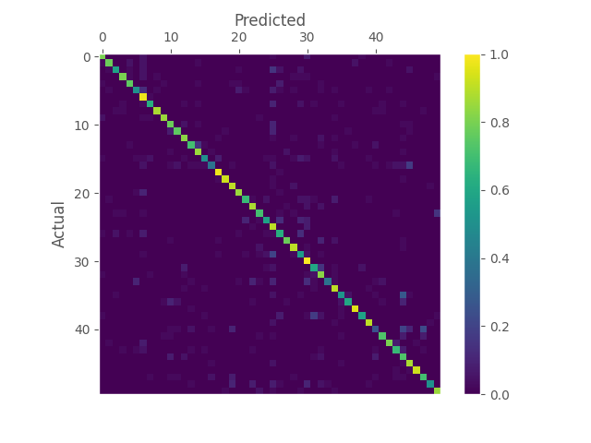
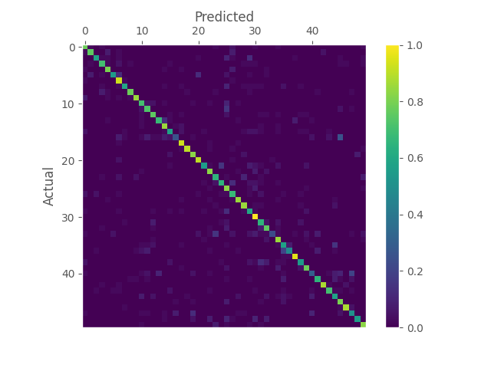


Confusion Matricies
BNN
BNN Ensemble
CNN
CNN Ensemble

Slide 26
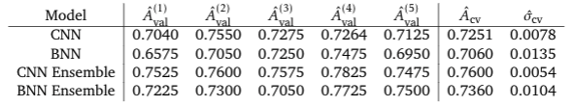
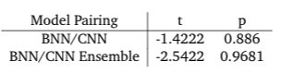
5-fold Cross Validation Accuracies

Slide 27

Conclusion

Slide 28
Conclusion
There was insufficient evidence to reject the null hypotheses that BNNs performed equally well if not worse than comparable CNNs
Potential sharp loss function associated with audio classification problems
Audio classification problems may conform to the manifold hypothesis more than originally anticipated
It would be worthwhile investigating these ideas further
Different datasets
Different architectures

Slide 29

Thank you for listening
Any Questions?

Slide 30
References
[1] Meinard Muller. ¨ Fundamentals of music processing: Audio, analysis, algorithms, applications. Springer, 2015.
[2] Yaser S Abu-Mostafa, Malik Magdon-Ismail, and Hsuan-Tien Lin. Learning from data, volume 4. AMLBook New York, NY, USA:, 2012.
[3] Ian Goodfellow, Yoshua Bengio, and Aaron Courville. Deep Learning. MIT Press, 2016. http://www.deeplearningbook.org.
[4] Aur´elien G´eron. Hands-on machine learning with Scikit-Learn, Keras, and TensorFlow: Concepts, tools, and techniques to build intelligent systems. O’Reilly Media, 2019.
[5] Andrew Gordon Wilson and Pavel Izmailov. Bayesian deep learning and a probabilistic perspective of generalization. arXiv preprint arXiv:2002.08791, 2020.
[6] Charles Blundell, Julien Cornebise, Koray Kavukcuoglu, and Daan Wierstra. Weight uncertainty in neural network. In International Conference on Machine Learning, pages 1613–1622. PMLR, 2015.
[7] Stanislav Fort, Huiyi Hu, and Balaji Lakshminarayanan. Deep ensembles: A loss landscape perspective. arXiv preprint arXiv:1912.02757, 2019.

Slide 31
References
[8] Hohyub Jeon, Yongchul Jung, Seongjoo Lee, and Yunho Jung. Area-efficient short-time fourier transform processor for time– frequency analysis of non-stationary signals. Applied Sciences, 10(20):7208, 2020.
[9] Douglas O’shaughnessy. Speech Communications: Human And Machine (ieee). Universities press, 1987.
[10] Jaehun Kim. Urban sound tagging using multi-channel audio feature with convolutional neural networks. Proceedings of the Detection and Classification of Acoustic Scenes and Events, 2020.
[11] Loris Nanni, Gianluca Maguolo, Sheryl Brahnam, and Michelangelo Paci. An ensemble of convolutional neural networks for audio classification. Applied Sciences, 11(13):5796, 2021.
[12] Md Mohaimenuzzaman, Christoph Bergmeir, Ian Thomas West, and Bernd Meyer. Environmental sound classification on the edge: A pipeline for deep acoustic networks on extremely resource-constrained devices. arXiv preprint arXiv:2103.03483, 2021.
[13] Karol J Piczak. Environmental sound classification with convolutional neural networks. In 2015 IEEE 25th international workshop on machine learning for signal processing (MLSP), pages 1–6. IEEE, 2015.

